Slide 1

Stock Market Analysis

Slide 2
Presented by group 6
- Syed Mohd Altamash
- Boddapu Harsha Vardhan
- Syed Asfan
Mentors :

Slide 3
PROBLEM STATEMENT Creating Stock Market Analysis measurement dataset.
OBJECTIVES :
Data set details
EDA
Model Building
Deployment using streamlit

Slide 4
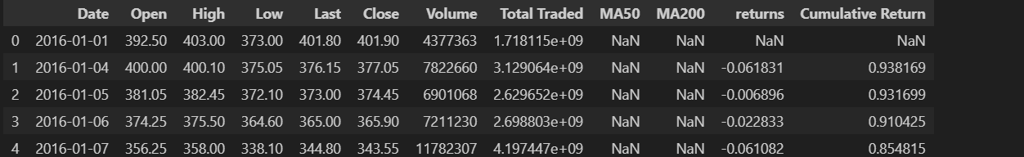
OVERALL VIEW OF THE GIVEN DATA

Slide 5
Missing values
we'll fill missing values by three ways:
Dropping Columns with High Missing Values
Filling Numerical Columns with Mean
Filling Categorical Columns with Mode

Slide 6
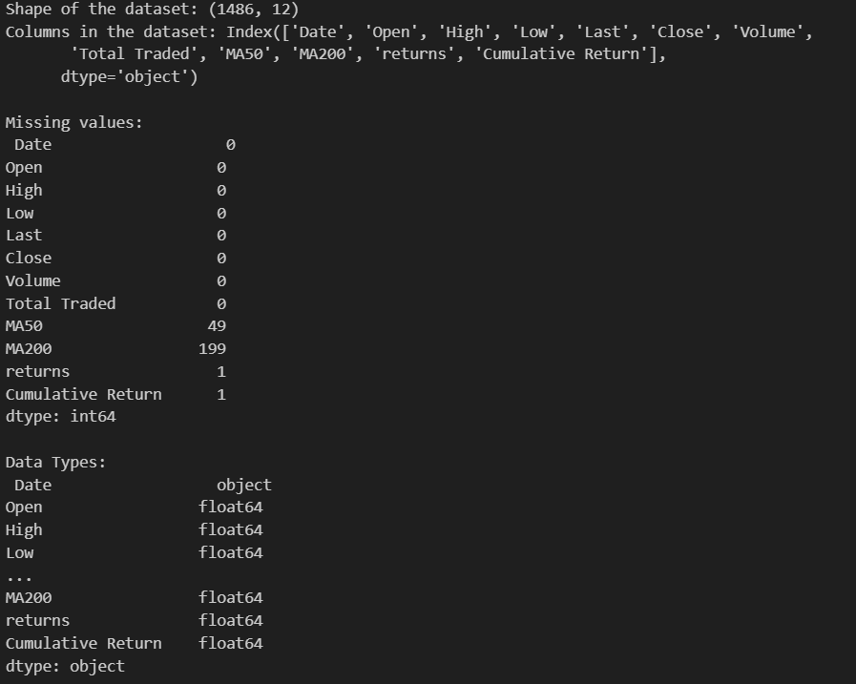
Dropping columns with high missing values
_If a columns have a large proportion of missing values e.g.,Ease of business has 2,519 missing values out of 2,704 it might be practical to drop them,because they don’t contribute much to analysis.

Slide 7
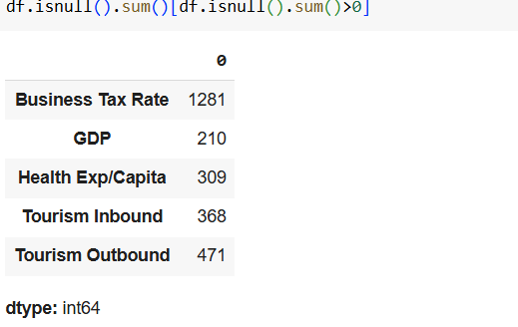
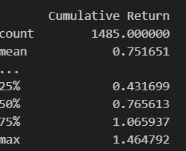
Filling Numerical Columns With Mean

Slide 8
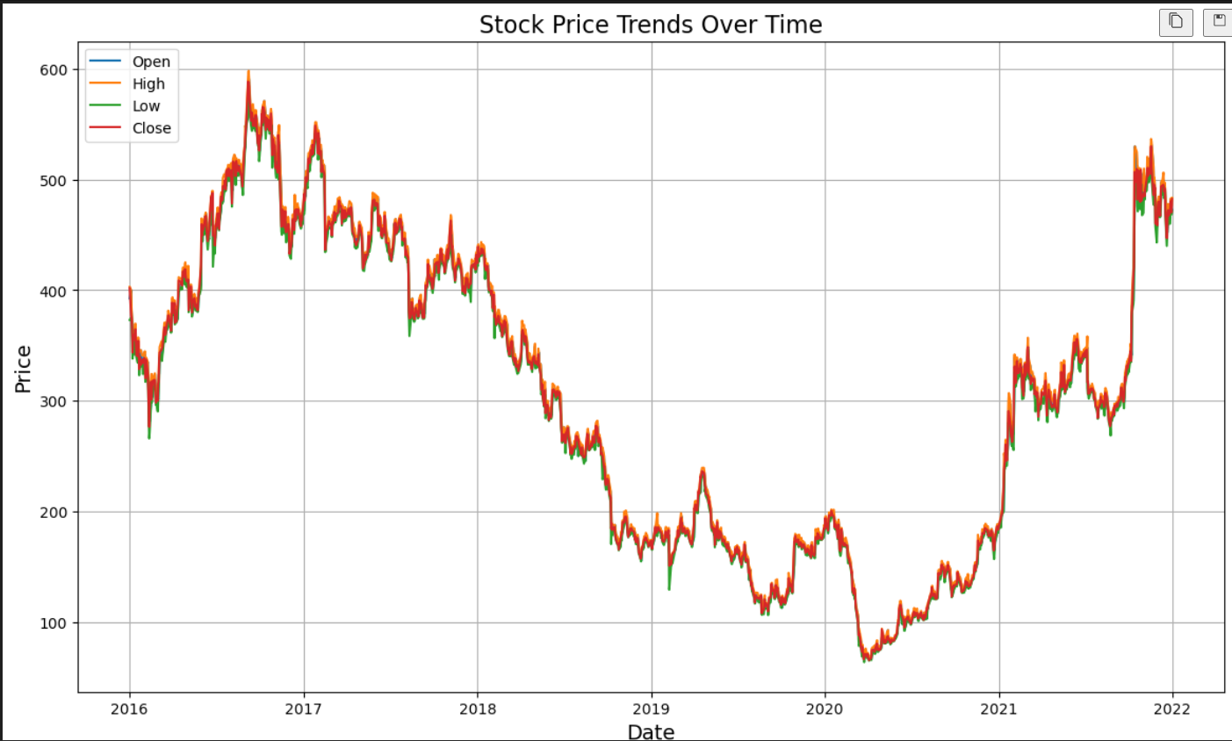
EDA
Histogram for numerical columns
Histograms show the distribution of individual numerical columns, which is useful for understanding data spread, skewness, and common values.

Slide 9
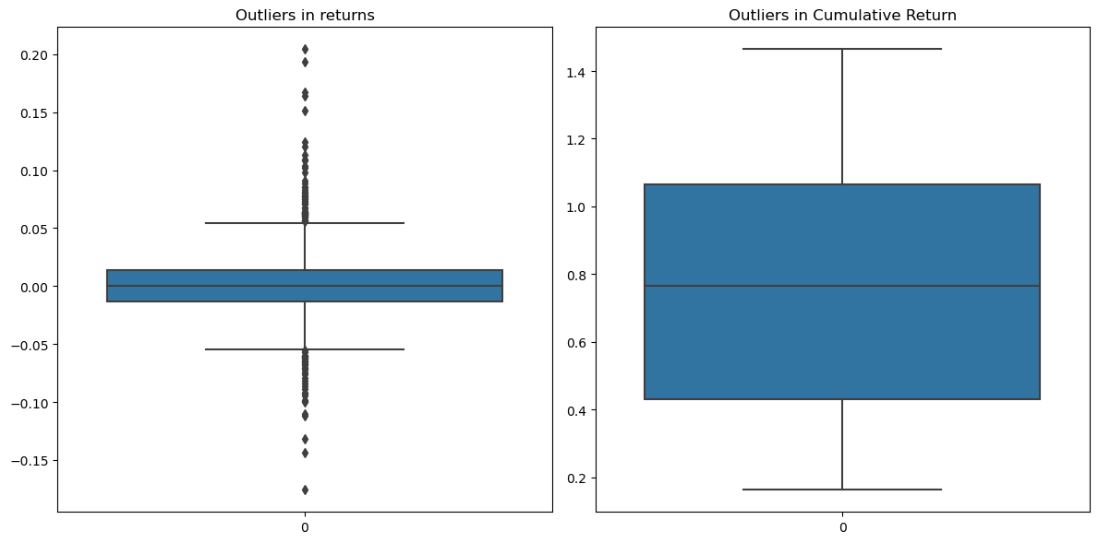
Box Plot Box plots help detect outliers in numerical columns by showing the spread and identifying extreme values.

Slide 10
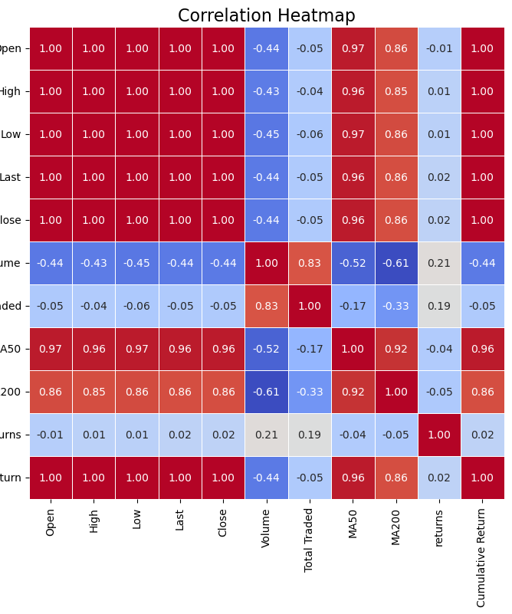
Correlation Heatmap A heatmap of correlations helps reveal relationships among numerical features, indicating how they might interact with each other.

Slide 11
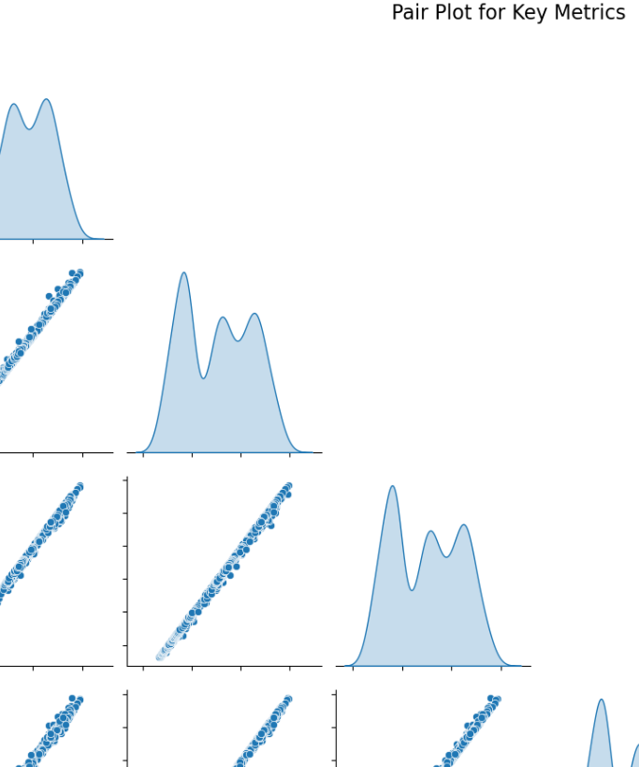
Pair plot Pair plots allow you to visualize the relationships between several numerical features at once, showing distributions on the diagonal and scatter plots on the off-diagonals.

Slide 12
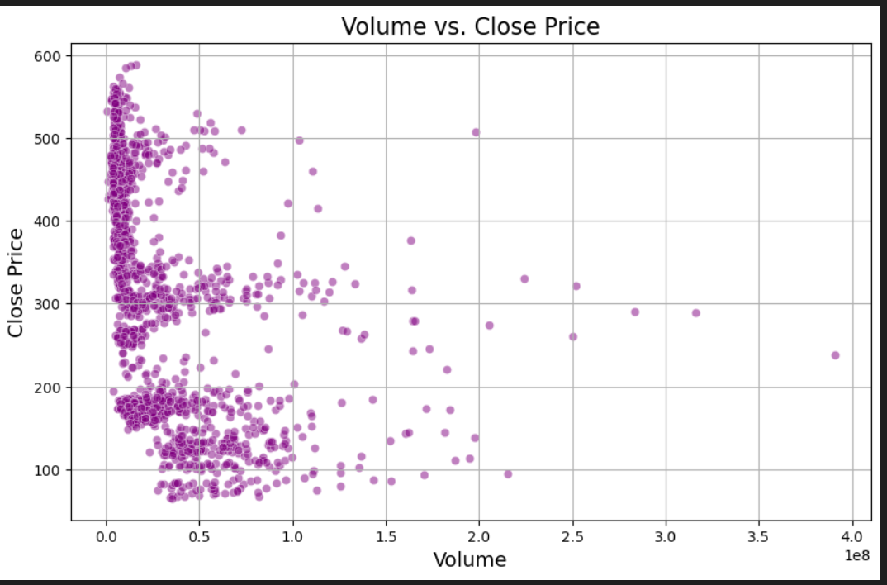
SCATTER PLOTS _help visualize the relationship between two numerical columns.

Slide 13
Conclusion on EDA
EDA revealed key trends and seasonality patterns in stock price data, such as daily, monthly, and yearly movements.
Visualizations highlighted significant relationships between technical indicators (e.g., moving averages, RSI) and stock price trends.
Missing values and anomalies in historical stock data were identified and handled effectively.
Correlation analysis showed the influence of specific features like volume and market sentiment on stock price movements.
Outlier detection helped refine the dataset for accurate predictive modeling.
Statistical summaries provided insights into stock price volatility and distribution over time.
Feature engineering based on EDA improved model input quality, enhancing prediction performance.
Overall, EDA was instrumental in understanding the dataset and forming a solid base for building reliable predictive models.

Slide 14

STANDARDIZING THE DATA BY USING NORMALIZATION
Normalizing the features using standardscalar to prevent large ranged features dominancy and to improve the model performance
Standardizer = standardscalar()
Features_standardized = standardizer.fit_transform(features)

Slide 15
MODEL BUILDING
We are We are using three forecasting models in this project:
Prophet Model
Effective for handling seasonal patterns and holidays.
ARIMA (AutoRegressive Integrated Moving Average)
Suitable for time-series data with trends and patterns.
LSTM (Long Short-Term Memory)
A deep learning model designed for sequence prediction, capturing long-term dependencies in data.

Slide 16
Final Model Selection
After evaluating multiple forecasting models, the LSTM (Long Short-Term Memory) model was selected as the final model due to:
High Prediction Accuracy: It provided the lowest RMSE (Root Mean Square Error) of 15.07, outperforming other models like Prophet and ARIMA.
Ability to Handle Non-Linear Data: LSTM effectively captured the complex patterns and long-term dependencies in stock market data.
Real-Time Prediction Capability: Suitable for dynamic stock market environments, offering accurate trend forecasting.

Slide 17
Challenges Faced
Data Quality Issues: Handling missing, noisy, or inconsistent data in historical stock market records.
High Volatility: Predicting prices amidst unpredictable and sudden market changes.
Feature Engineering: Identifying and selecting the most relevant indicators for better predictions.
Model Selection: Balancing between accuracy and computational efficiency while choosing models.
Overfitting: Ensuring the models generalize well and do not only perform well on training data.
Interpretability: Explaining complex models like LSTM to non-technical stakeholders.
Deployment: Creating an intuitive dashboard for real-time forecasting and visualization.
Computational Limitations: Dealing with high resource requirements for training advanced models like LSTM.

